Slide 1
BASICS OF SOFTWARE TESTING
Saurabh Kandhway

Slide 2

About me

Slide 3
What is software
Software is a collection of instructions, data, or computer programs that are used to run machines and carry out particular activities. It is the antithesis of hardware, which refers to a computer’s external components. A device’s running programs, scripts, and applications are collectively referred to as “software” in this context.
In a computer system, the software is basically a set of instructions or commands that tell a computer what to do. In other words, the software is a computer program that provides a set of instructions to execute a user’s commands and tell the computer what to do. For example like MS-Word, MS-Excel, PowerPoint, etc.

Slide 4
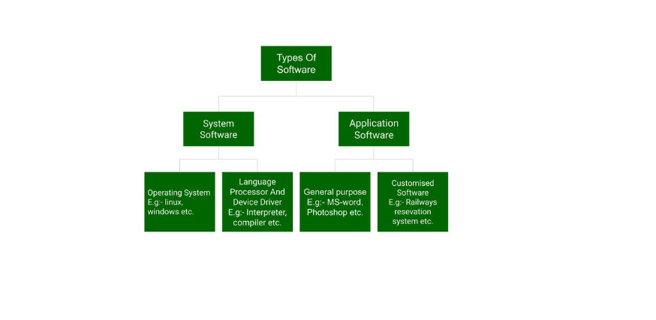
Types of Software

Slide 5
System software
System Software is software that directly operates the computer hardware and provides the basic functionality to the users as well as to the other software to operate smoothly. Or in other words, system software basically controls a computer’s internal functioning and also controls hardware devices such as monitors, printers, and storage devices, etc.
Features
System Software is closer to the computer system.
System Software is written in a low-level language in general.
System software is difficult to design and understand.

Slide 6
Application software
Software that performs special functions or provides functions that are much more than the basic operation of the computer is known as application software. Or in other words, application software is designed to perform a specific task for end-users. It is a product or a program that is designed only to fulfill end-users’ requirements. It includes word processors, spreadsheets, database management, inventory, payroll programs, etc.
Features of Application Software
Let us discuss some of the features of Application Software:
An important feature of application software is it performs more specialized tasks like word processing, spreadsheets, email, etc.
Mostly, the size of the software is big, so it requires more storage space.
Application software is more interactive for the users, so it is easy to use and design.

Slide 7
Types of Team in an organization
Functional team
Functional teams are the most traditional corporate units that are typically represented by departments, as all the team members belong to the same department. A functional team consists of people who have similar professional expertise, which means it's homogeneous.
Cross Functional Team
A cross-functional team is composed of representatives of various departments that have diverse functional expertise and skills but still work on the same objectives.

Slide 8
Types of Team in an organization
Self Managed Teams
A self-managed team is a group of employees who work collaboratively and take full responsibility for both work processes and the final result. They work autonomously, without the supervision of a manager. This means that besides creating products or services, they also perform basic management functions - organizing, planning, leading, and controlling . In self-managed teams, the decision-making power is distributed horizontally among team members. People make commitments to each other rather than to a leader.
Team of Teams
This is a team that comprises various departments of the same organization. It’s larger than a typical team but smaller than an organization. The purpose of a team of teams is to solve complex problems that require coordination.

Slide 9
What is software quality assurance
Software Quality Assurance (SQA) is the practice of monitoring all software engineering processes, activities, and methods used in a project to ensure proper quality of the software and conformance against the defined standards. Software Quality Assurance (QA) Testing evaluates the functional, performance, usability and security of the software or app.
Software Quality Assurance (QA) Testing Benefits:
Software Quality Assurance (QA) not only is beneficial to the vendor, but the consumer as well. Credible Software QA Testing can establish expectations for the product while helping a manufacturer produce high quality software. Sacrificing usability, stability and security is not an option if you want your app, software or cloud-based service representing your brand reputation.

